Slide 1
Deal.Me
IBM Team 2
David Le, Aditya Modi, Nima Rahnemoon, Rohit Seth, Jessica Tai, Stephanie Tung, Uen-tao Wang, David Yang

Slide 2
Motivation
Many online deal listing sites
Additional steps/sites needed for:
More information on deal venues
More type specificity
Directions
Locality
Including friends

Slide 3
Goal: Deal.Me Website
Aggregate deals by
Location
Type (dining, entertainment, shopping, etc)
Provide more information
Yelp stars, preview of reviews
Directions to venue
Social media integration

Slide 4





System Overview
API web mash-up
Yipit : deal aggregator
Google maps : location, directions
Yelp: reviews, ratings
FB: share with friends, events
Twitter: tweet to friends
Google Web Toolkit (GWT)
Java RPC
JSON
Bootstrap (based off of Twitter’s)

Slide 5
Architecture Diagram
Model-view-presenter (MVP) architecture
(demo code architecture)
(explain why chose MVP)
Easy separation of tasks

Slide 6
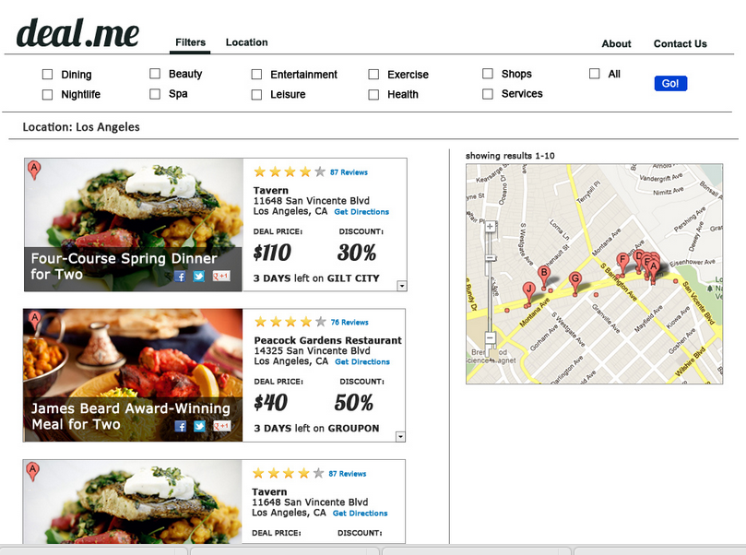
Interface Design

Slide 7
UML/Sequence Diagrams
UI widget → servlet → RPC call → parse data → client (UI)?
(Insert diagram)

Slide 8
Workflows

Slide 9
Other Considerations
Security
Not necessary
Users not required to log-in
Database
Not necessary
No information stored about user info/activity

Slide 10
Schedule & Milestones
Requirements/SRS
Complete skeleton code
Finalize design mockups
Complete final implementation of subsets
Yipit API
Google maps API
Yelp API
Social media (FB/Twitter)
Final report
Demo
(Dates? Percentages?)

Slide 11
Progress Thus Far
(demo?)
Completed components
Yipit parser
Skeleton code for application
(Completed?) Google maps and geolocation widget
(Completed?) deal listing and topbar widgets

Slide 12
Challenges & Lessons Learned
Should establish more concrete milestones earlier
More frequent progress check-ins
Apply earlier for BiteHunter API

Slide 13
Uncompleted Tasks

